Slide 1
a
c
a*sin(θ)
θ
a*cos(θ)
b

Slide 2
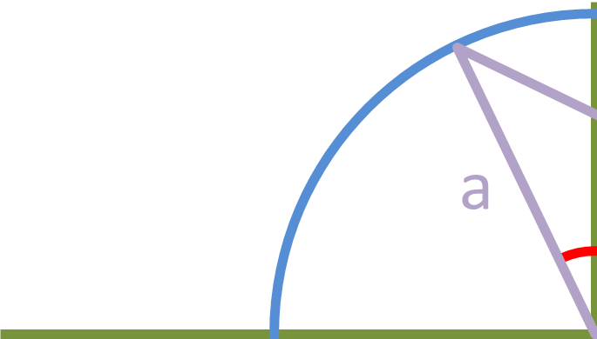
(a*cos(θ),a*sin(θ))

Slide 3
$$c2=\left(a∗\sin\left(θ\right)\right)2 +\left(b−a∗cos⁡(θ)\right)2$$

Slide 4
$$c2=\left(a2∗(1)\right)+ (b2−2ab∗cos(θ))$$
$$c2=\left(a2\right)+ (b2−2ab∗cos(θ))$$

